Slide 1

CUDA
(Compute Unified Device Architecture)
Supercomputing for the Masses
by Peter Zalutski

Slide 2
What is CUDA?
  CUDA is a set of developing tools to create applications that will perform execution on GPU (Graphics Processing Unit).
  CUDA compiler uses variation of C with future support of C++
  CUDA was developed by NVidia and as such can only run on NVidia GPUs of G8x series and up.
  CUDA was released on February 15, 2007 for PC and Beta version for MacOS X on August 19, 2008.

Slide 3
Why CUDA?
  CUDA provides ability to use high-level languages such as C to develop application that can take advantage of high level of performance and scalability that GPUs architecture offer.
  GPUs allow creation of very large number of concurrently executed threads at very low system resource cost.
  CUDA also exposes fast shared memory (16KB) that can be shared between threads.
  Full support for integer and bitwise operations.
  Compiled code will run directly on GPU.

Slide 4
CUDA limitations
  No support of recursive function. Any recursive function must be converted into loops.
  Many deviations from Floating Point Standard (IEEE 754).
  No texture rendering.
  Bus bandwidth and latency between GPU and CPU is a bottleneck for many applications.
  Threads should only be run in groups of 32 and up for best performance.
  Only supported on NVidia GPUs

Slide 5
GPU vs CPU
  GPUs contain much larger number of dedicated ALUs then CPUs.
  GPUs also contain extensive support of Stream Processing paradigm. It is related to SIMD ( Single Instruction Multiple Data) processing.
  Each processing unit on GPU contains local memory that improves data manipulation and reduces fetch time.

Slide 6
CUDA Toolkit content
  The nvcc C compiler.
  CUDA FFT (Fast Fourier Transform) and BLAS (Basic Linear Algebra Subprograms for linear algebra) libraries for the GPU.
  Profiler.
  An alpha version of the gdb debugger for the GPU.
  CUDA runtime driver.
  CUDA programming manual.

Slide 7
CUDA Example 1
#define COUNT 10
#include <stdio.h>
#include <assert.h>
#include <cuda.h>
int main(void)
{
float* pDataCPU = 0;
float* pDataGPU = 0;
int i = 0;
//allocate memory on host
pDataCPU = (float*)malloc(sizeof(float) * COUNT);

Slide 8
CUDA Example 1 (continue)
//allocate memory on GPU
cudaMalloc((void**) &pDataGPU, sizeof(float) * COUNT);
//initialize host data
for(i = 0; i < COUNT; i++)
{
pDataCPU[i] = i;
}
//copy data from host to GPU
cudaMemcpy(pDataGPU, pDataCPU, sizeof(float) * COUNT,
cudaMemcpyHostToDevice);

Slide 9
CUDA Example 1 (continue)
//do something on GPU (Example 2 adds here)
..................
..................
..................
//copy result data back to host
cudaMemcpy(pDataCPU, pDataGPU, sizeof(float) * COUNT,
cudaMemcpyDeviceToHost);
//release memory
free(pDataCPU);
cudaFree(pDataGPU)
return 0;
}

Slide 10
CUDA Example 1 (notes)
  This examples does following:
    Allocates memory on host and device (GPU).
    Initializes data on host.
    Performs data copy from host to device.
    After some arbitrary processing data is copied from device to host.
    Memory is freed from both host and device.
  cudaMemcpy() is function that allows basic data move operation.There are several operators that are passed in:
    cudaMemcpyHostToDevice - copy from CPU->GPU.
    cudaMemcpyDeviceToHost - copy from GPU->CPU.
    cudaMemcpyDeviceToDevice - copy data between allocated memory buffers on device.

Slide 11
CUDA Example 1 (notes continue)
  Memory allocation is done using cudaMalloc() and deallocation cudaFree()
  Maximum of allocated memory is device specific.
  Source files must have extension ".cu".

Slide 12
CUDA Example 2 (notes)
  For many operations CUDA is using kernel functions. These functions are called from device (GPU) and are executed on it simultaneously by many threads in parallel.
  CUDA provides several extensions to the C-language. "__global__" declares kernel function that will be executed on CUDA device. Return type for all these functions is void. We define these functions.
  Example 2 will feature incrementArrayOnDevice CUDA kernel function. Its purpose is to increment values of each element of an array. All elements will be incremented by this single instruction, in the same time using parallel execution and multiple threads.

Slide 13
CUDA Example 2
  We will modify example 1 by adding code in between memory copy from host to device and from device to host.
  We will also define following kernel function:
__global__ void incrementArrayOnDevice(float* a, int size)
{
int idx = blockIdx.x * blockDim.x + threadIdx.x;
if(idx < size)
{
a[idx] = a[idx] + 1;
}
}
Explanation of this function will follow after code.

Slide 14
CUDA Exmple 2
//inserting code to perform operations on GPU
int nBlockSize = 4;
int nBlocks = COUNT / nBlockSize + (COUNT % nBlockSize
== 0 ? 0 : 1);
//calling kernel function
incrementArrayOnDevice <<< nBlocks, nBlockSize >>
(pDataGPU, COUNT);
//rest of the code
...........
...........

Slide 15
CUDA Example 2 (notes)
  When we call kernel function we provide configuration values for that function. Those values are included within "<<<" and ">>>" brackets.
  In order to understand nBlock and nBlockSize configuration values we must examine what is thread blocks.
  Thread block is organization of processing units that can communicate and synchronize with each other. Higher number of threads per block involves higher cost of hardware since blocks are physical devices on GPU.

Slide 16
Example 2 (notes continue)
  Grid Abstraction was introduced to solve problem with different hardware having different number of threads per block.
  In Example 2 nBlockSize identifies number of threads per block. Then we use this information to calculate number of blocks needed to perform kernel call based on number of elements in the array. Computed value is nBlocks.
  There are several built in variables that are available to kernel call:
    blockIdx - block index within grid.
    threadIdx - thread index within block.
    blockDim - number of threads in a block.

Slide 17
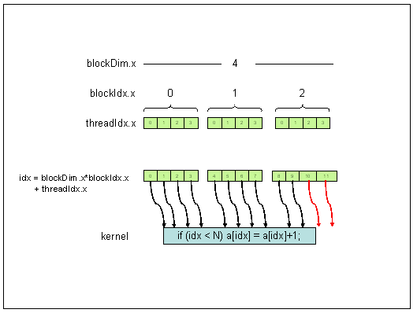
Example 2 (notes continue)
Diagram of block breakdown and thread assignment for our array.
(Rob Farber, "CUDA, Supercomputing for the Masses: Part 2", Dr.Dobbs,
http://www.ddj.com/hpc-high-performance-computing/207402986)

Slide 18
CUDA - Code execution flow
  At application start of execution CUDA's compiled code runs like any other application. Its primary execution is happening in CPU.
  When kernel call is made, application continue execution of non-kernel function on CPU. In the same time, kernel function does its execution on GPU. This way we get parallel processing between CPU and GPU.
  Memory move between host and device is primary bottleneck in application execution. Execution on both is halted until this operation completes.

Slide 19
CUDA - Error Handling
  For non-kernel CUDA calls return value of type cudaError_t is provided to requestor. Human-radable description can be obtained by char* cudaGetErrorString(cudaError_t code);
  CUDA also provides method to retrieve last error of any previous runtime call cudaGetLastError(). There are some considirations:
    Use cudaThreadSynchronize() to block for all kernel calls to complete. This method will return error code if such occur. We must use this otherwise nature of asynchronous execution of kernel will prevent us from getting accurate result.

Slide 20
CUDA - Error Handling (continue)
    cudaGetLastError() only return last error reported. Therefore developer must take care to properly requesting error code.

Slide 21
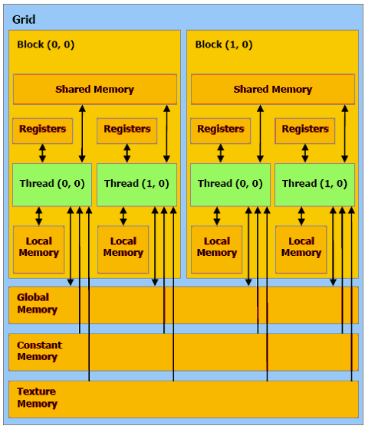
CUDA - Memory Model
Diagram depicting memory organization.
(Rob Farber, "CUDA, Supercomputing for the Masses: Part 4", Dr.Dobbs, http:http://www.ddj.com/architect/208401741?pgno=3//www.ddj.com/hpc-high-performance-computing/207402986)

Slide 22
CUDA - Memory Model (continue)
  Each block contain following:
    Set of local registers per thread.
    Parallel data cache or shared memory that is shared by all the threads.
    Read-only constant cache that is shared by all the threads and speeds up reads from constant memory space.
    Read-only texture cache that is shared by all the processors and speeds up reads from the texture memory space.
  Local memory is in scope of each thread. It is allocated by compiler from global memory but logically treated as independent unit.

Slide 23
CUDA - Memory Units Description
  Registers:
    Fastest.
    Only accessible by a thread.
    Lifetime of a thread
  Shared memory:
    Could be as fast as registers if no bank conflicts or reading from same address.
    Accessible by any threads within a block where it was created.
    Lifetime of a block.

Slide 24
CUDA - Memory Units Description
(continue)
  Global Memory:
    Up to 150x slower then registers or share memory.
    Accessible from either host or device.
    Lifetime of an application.
  Local Memory
    Resides in global memory. Can be 150x slower then registers and shared memory.
    Accessible only by a thread.
    Lifetime of a thread.

Slide 25
CUDA - Uses
  CUDA provided benefit for many applications. Here list of some:
    Seismic Database - 66x to 100x speedup http://www.headwave.com.
    Molecular Dynamics - 21x to 100x speedup http://www.ks.uiuc.edu/Research/vmd
    MRI processing - 245x to 415x speedup http://bic-test.beckman.uiuc.edu
    Atmospheric Cloud Simulation - 50x speedup http://www.cs.clemson.edu/~jesteel/clouds.html.

Slide 26
CUDA - Resources & References
  CUDA, Supercomputing for the Masses by Rob Farber.
    http://www.ddj.com/architect/207200659.
  CUDA, Wikipedia.
    http://en.wikipedia.org/wiki/CUDA.
  Cuda for developers, Nvidia.
    http://www.nvidia.com/object/cuda_home.html#.
  Download CUDA manual and binaries.
    http://www.nvidia.com/object/cuda_get.html

